Slide 1
Computational Physics (Lecture 13)
PHY4061

Slide 2
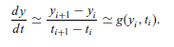
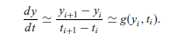
The Euler and Picard methods
Numerically, we can rewrite the velocity as:
Here, i is the ith time step.
Let g_{i} = g(y_{i}, t_{i}), τ=t_{i+1} – t_{i}, then we have: (the Euler Method)

Slide 3
Problem of the Euler method:
Low accuracy
The error accumulates!
We just can’t apply this method to most problems.

Slide 4
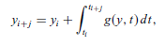
Rewrite the equation:
If we can integrate the second part, we will get the exact solution.

Slide 5
We cannot obtain the integral in general.
Approximation is important.

Slide 6
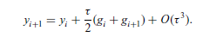
The Picard method
Adaptive scheme
each iteration carried out by using the solution from the previous iteration as the input on the right-hand side
For example, if we choose j = 1 and use the trapezoid rule for the integral, we obtain the algorithm

Slide 7
Problem of the Picard method
Problem: Can be very slow. May have convergence problem if the initial guess is not close to the actual solution.
Any suggestions on how to improve this method?

Slide 8
Predictor--corrector methods
apply a less accurate algorithm to predict the next value y_{i+1} first.
for example, using the Euler algorithm and then apply a better algorithm to improve the new value (Picard algorithm).

Slide 9
// A program to study the motion of a particle under an
// elastic force in one dimension through the simplest
// predictor-corrector scheme.
import java.lang.*;
public class Motion2 {
static final int n = 100, j = 5;
public static void main(String argv[]) {
double x[] = new double[n+1];
double v[] = new double[n+1];
// Assign time step and initial position and velocity
double dt = 2*Math.PI/n;
x[0] = 0;
v[0] = 1;
// Calculate other position and velocity recursively
for (int i=0; i<n; ++i) {
// Predict the next position and velocity
x[i+1] = x[i]+v[i]*dt;
v[i+1] = v[i]-x[i]*dt;
// Correct the new position and velocity
x[i+1] = x[i]+(v[i]+v[i+1])*dt/2;
v[i+1] = v[i]-(x[i]+x[i+1])*dt/2;
}
// Output the result in every j time steps
double t = 0;
double jdt = j*dt;
for (int i=0; i<=n; i+=j) {
System.out.println(t +" " + x[i] +" " + v[i]);
t += jdt;
}
}
}

Slide 10
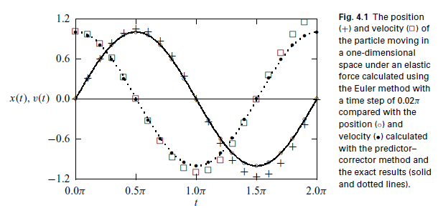

Slide 11
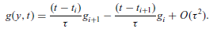
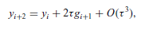
Another way to improve an algorithm is by increasing the number of mesh points j.
Thus we can apply a better quadrature to the integral.
For example, if we take j = 2, and then use the linear interpolation scheme to approximate g(y, t) in the integral from g_{i} and g_{i+1},

Slide 12
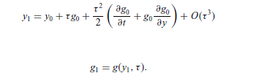
One order of magnitude better than Euler.
need the values of the first two points in order to start this algorithm.
can be obtained by the Taylor expansion around the initial point at t = 0.
Can we include more points and achieve higher accuracies?

Slide 13
we can always include more points in the integral to obtain a higher accuracy
we will need the values of more points to start the algorithm!
impractical if we need more than two points in order to start the algorithm.
the errors accumulated from the approximations of the first few points will eliminate the apparently high accuracy of the algorithm!

Slide 14
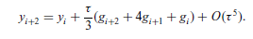
We can make the accuracy even higher by using a better quadrature.
For example, we can take j = 2 and apply the Simpson rule to the integral.
We can use this one as the corrector and the algorithm of O(τ³) as the predictor.

Slide 15
One simple model a motorcycle jump over a gap:
The air resistance on a moving object is roughly given by f_{r}=-κvv = −cAρvv, where A is cross section of the moving object, ρ is the density of the air, and c is a coefficient that accounts for all the other factors on the order
of 1.

Slide 16
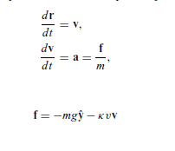

Slide 17
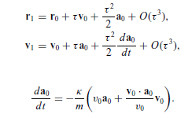
Assuming that we have the first point given, that is, r₀ and v₀ at t = 0,
the next point is then obtained from the Taylor expansions and the equation set with

Slide 18
// An example of modeling a motorcycle jump with the
// two-point predictor-corrector scheme.
import java.lang.*;
public class Jump {
static final int n = 100, j = 2;
public static void main(String argv[]) {
double x[] = new double[n+1];
double y[] = new double[n+1];
double vx[] = new double[n+1];
double vy[] = new double[n+1];
double ax[] = new double[n+1];
double ay[] = new double[n+1];
// Assign all the constants involved
double g = 9.80;
double angle = 42.5*Math.PI/180;
double speed = 67;
double mass = 250;
double area = 0.93;
double density = 1.2;
double k = area*density/(2*mass);
double dt = 2*speed*Math.sin(angle)/(g*n);
double d = dt*dt/2;
// Assign the quantities for the first two points
x[0] = y[0] = 0;
vx[0] = speed*Math.cos(angle);
vy[0] = speed*Math.sin(angle);
double v = Math.sqrt(vx[0]*vx[0]+vy[0]*vy[0]);
ax[0] = -k*v*vx[0];
ay[0] = -g-k*v*vy[0];
double p = vx[0]*ax[0]+vy[0]*ay[0];
x[1] = x[0]+dt*vx[0]+d*ax[0];
y[1] = y[0]+dt*vy[0]+d*ay[0];
vx[1] = vx[0]+dt*ax[0]-d*k*(v*ax[0]+p*vx[0]/v);
vy[1] = vy[0]+dt*ay[0]-d*k*(v*ay[0]+p*vy[0]/v);
v = Math.sqrt(vx[1]*vx[1]+vy[1]*vy[1]);
ax[1] = -k*v*vx[1];
ay[1] = -g-k*v*vy[1];
// Calculate other position and velocity recursively
double d2 = 2*dt;
double d3 = dt/3;
for (int i=0; i<n-1; ++i) {

Slide 19
// Predict the next position and velocity
x[i+2] = x[i]+d2*vx[i+1];
y[i+2] = y[i]+d2*vy[i+1];
vx[i+2] = vx[i]+d2*ax[i+1];
vy[i+2] = vy[i]+d2*ay[i+1];
v = Math.sqrt(vx[i+2]*vx[i+2]+vy[i+2]*vy[i+2]);
ax[i+2] = -k*v*vx[i+2];
ay[i+2] = -g-k*v*vy[i+2];
// Correct the new position and velocity
x[i+2] = x[i]+d3*(vx[i+2]+4*vx[i+1]+vx[i]);
y[i+2] = y[i]+d3*(vy[i+2]+4*vy[i+1]+vy[i]);
vx[i+2] = vx[i]+d3*(ax[i+2]+4*ax[i+1]+ax[i]);
vy[i+2] = vy[i]+d3*(ay[i+2]+4*ay[i+1]+ay[i]);
}
// Output the result in every j time steps
for (int i=0; i<=n; i+=j)
System.out.println(x[i] +" " + y[i]);
}
}
we have used the cross section A = 0.93 m^2, the takingoff speed v0 = 67 m/s, the air density = 1.2 kg/m^3, the combined mass of the
motorcycle and the person 250 kg, and the coefficient c = 1.

Slide 20
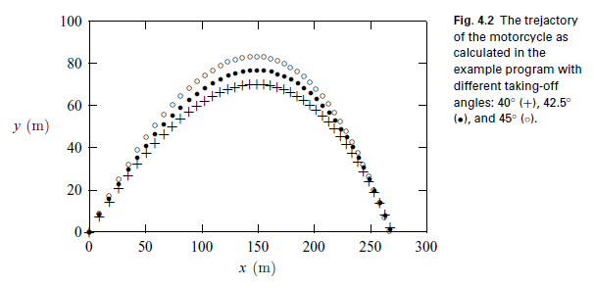

Slide 21
The Runge–Kutta method
A more practical method that requires only the first point in order to start or to improve the algorithm is the Runge–Kutta method, which is derived from two different Taylor expansions of the dynamical variables and their derivatives.
For details, please read the textbook.

Slide 22
Boundary-value and eigenvalue problems
A typical boundary-value problem in physics is usually given as a second-order differential equation
u’’ = f( u, u’, x)
where u is a function of x, u’ and u’’ are the first-order and second-order derivatives of u with respect to x, and f (u, u’; x) is a function of u, u’, and x.
Either u or u’ is given at each boundary point.

Slide 23
we can always choose a coordinate system
so that the boundaries of the system are at x = 0 and x = 1 without losing any generality
if the system is finite.
For example, if the actual boundaries are at x = x1 and x = x2 for a given problem, we can always bring them back to x’ = 0, and x = 1 with a transformation of x’=(x-x1)/(x2-x1)

Slide 24
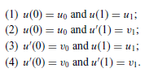
For problems in one dimension, we can have a total of four possible types of boundary conditions:
Do they look familiar to you?

Slide 25
more difficult to solve than the similar initial-value problem.
for the boundary-value problem, we know only u(0) or u’(0), which is not sufficient to start an algorithm for the initial-value problem without some further work.
Typical Eigen value problems are more difficult:
Have to handle one more parameter in the equation.
the eigenvalue λ can have only some selected values in order to yield acceptable solutions of the equation under the given boundary conditions.

Slide 26
The longitudinal vibrations along an elastic rod as an example:
u’’(x) = −k² u(x),
where u(x) is the displacement from equilibrium at x and the allowed values of k² are the eigenvalues of the problem.
The wavevector k in the equation is related to the phase speed c of the wave along the rod and the allowed angular frequency ω by the dispersion relation: ω = ck.

Slide 27
If both ends (x = 0 and x = 1) of the rod are fixed,
the boundary conditions are u(0) = u(1) = 0.
If one end (x = 0) is fixed and the other end (x = 1) is free,
the boundary conditions are then u(0) = 0 and u’(1) = 0.

Slide 28
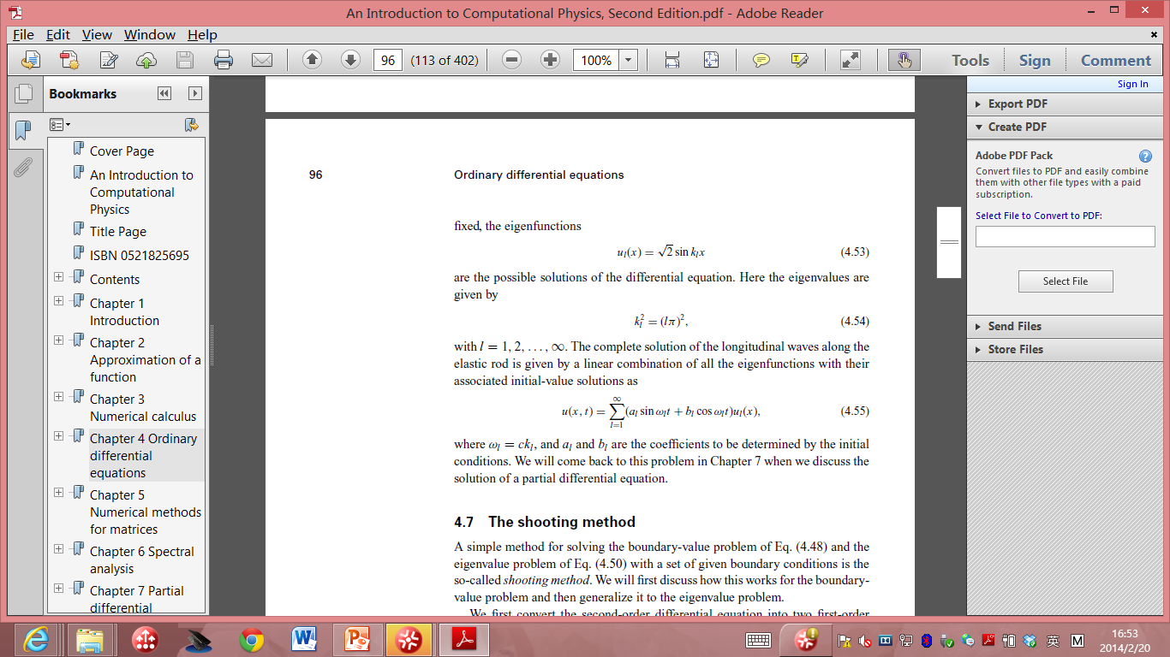
if both ends of the rod are fixed, the eigenfunctions:
the eigenvalues are :
K²_{l}= (lπ) ², l are positive integers.

Slide 29

The complete solution of the longitudinal waves along the elastic rod is given by a linear combination of all the eigenfunctions with their associated initial-value solutions as:
where ω_{l} = ck_{l} , and a_{l} and b_{l} are the coefficients to be determined by the initial conditions.

Slide 30
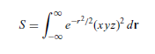
Project B
Send me a brief report (including code) and prepare a 5 min presentation.
Choose one of the following options: (each topic can be chosen by one students. First come, first serve.) You are highly encouraged to choose your own topic, which need my approval.
1 Write a 2D Ising model code and update each lattice site. Calculate the total energy as a function of your simulation steps and the possible critical temperature, plot your configuration, show the details of your simulations in your presentation. You can self define some parameters with reasonable physical justifications. (10% Bonus will be given if you try some block updating scheme we discussed in the class, still the maximum is capped at 100%)
2 Write a surface diffusion code to study nucleation problems on a 2D square lattice. You can define the parameters of vibrational frequencies, diffusion barriers (D) and deposition rate (R). Assume when the atoms meet each other, they will stay on the lattice site to form islands. From your simulation results, show that the number density of islands is proportional to (R/D)^{1/3} in your presentation.
3 Finish the following two problems: a) Calculate the integral with the Metropolis algorithm and compare the Monte Carlo result with the
exact result.
(b) Search on line to find algorithms and revise them to plot beautiful fractal shapes (smoke, fire …)or cartoons with random sampling approaches.
Find your own interested problems and perform Monte Carlo simulations. Need to get my approval.
Presentation will be scheduled in the last class. Please let me know your choice in two weeks.

